Slide 1
wrocław
a popular tourist destination in Poland

Slide 2
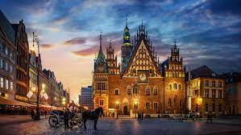
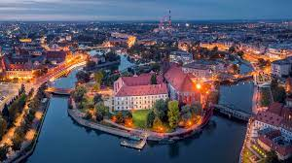
Wrocław
Wrocław - a city with poviat rights in south-west Poland. It is one of the largest cities in Poland.

Slide 3
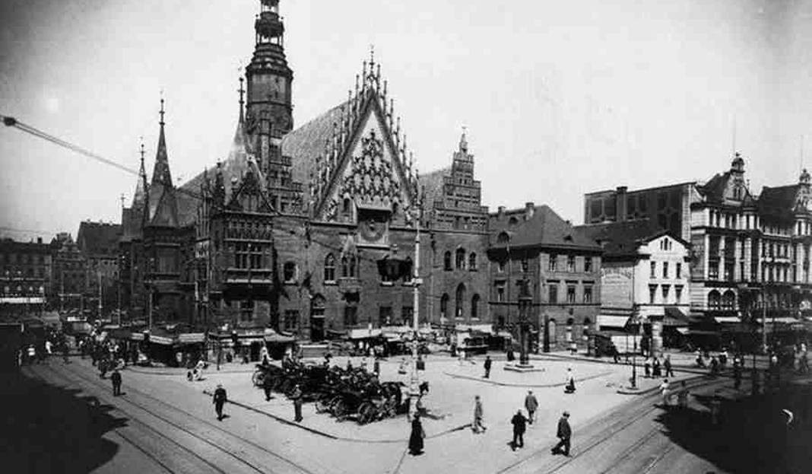
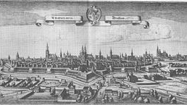
History of Wrocław
The very name of Wrocław comes from the name Wrocisław, probably the name of a Czech prince. The date of the official, contractual foundation of the city of Wrocław is considered to be 1000, when a bishopric was established in Wrocław by virtue of the Congress of Gniezno.

Slide 4
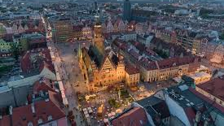
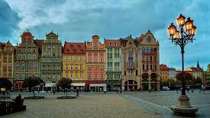
Attractions-courtyard
It is the heart of Wrocław, teeming with life at any time of the day or night. In the center of the nearly four-hectare square there are the Cloth Hall and the town hall building.

Slide 5
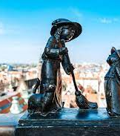
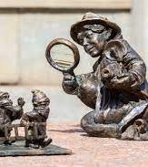
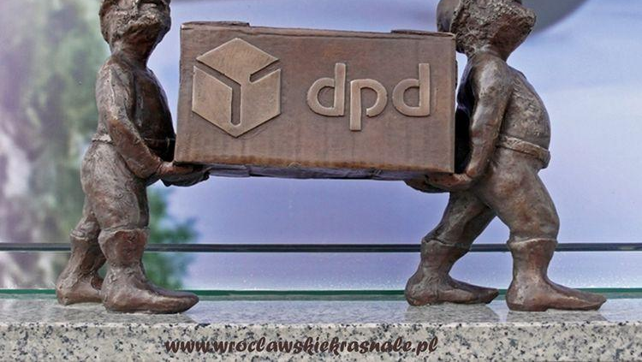
Wrocław- dwarfs
Small sculptures of dwarfs in a constantly increasing number have been placed in Wrocław successively since 2005.

Slide 6
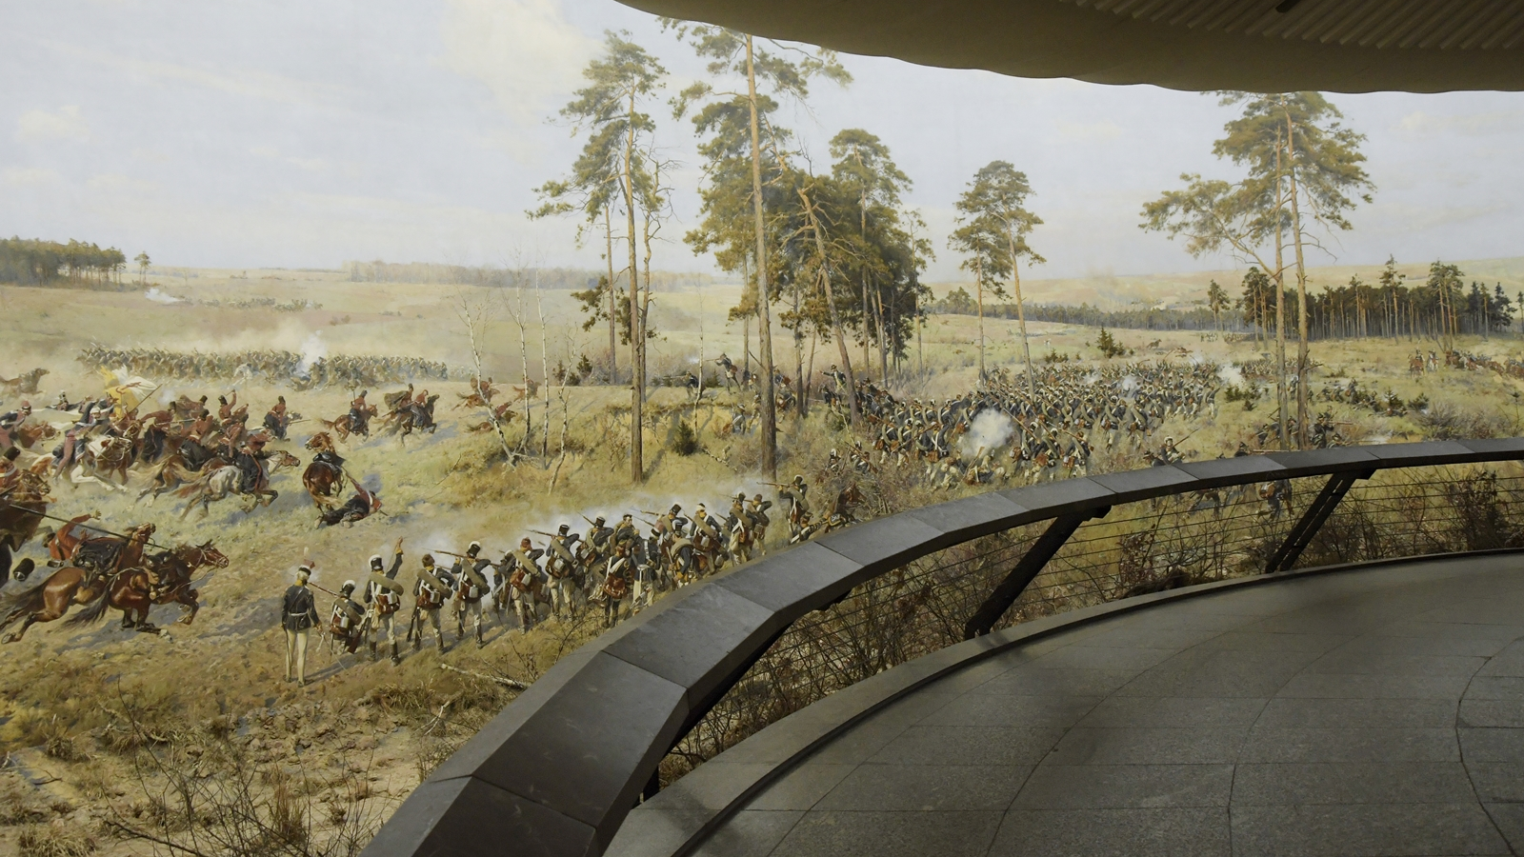
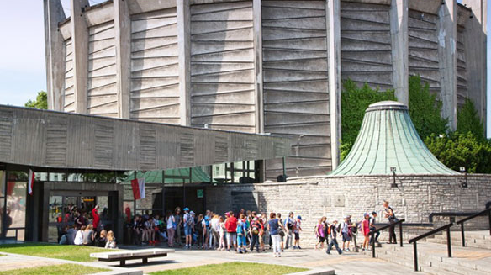
Attractions- Racławicka panorama
The inconspicuous rotunda-shaped building, located in the immediate vicinity of Galeria Dominikańska, is the famous museum of the Panorama of the Battle of Racławice.

