Slide 1
Football

Slide 2
ball game rules
There are two parts of the game in the match. There may be 11 players on the pitch of any chance, including one goalkeeper. It is unacceptable to start the game when the team has fewer than 7 players. The game is to score goals without the help of the upper limbs. It is allowed to play with the legs, head and cat parts of the torso. You kick the ball, transport it by throwing it with your feet. In the working area, catching the ball with your hands has the right only to the defender's goals. A goal is scored when the ball has passed the initial sale in its circuit. The team with the most goals wins the match. A draw is allowed, although sometimes in some situations where the score needs to be broken the playing time is extended by two extra periods. When overtime does not conclude, the penalty shootout screen will be displayed.ball game rules There are two parts of the game in the match. There may be 11 players on the pitch of any chance, including one goalkeeper. It is unacceptable to start the game when the team has fewer than 7 players. The game is to score goals without the help of the upper limbs. It is allowed to play with the legs, head and cat parts of the torso. You kick the ball, transport it by throwing it with your feet. In the working area, catching the ball with your hands has the right only to the defender's goals. A goal is scored when the ball has passed the initial sale in its circuit. The team with the most goals wins the match. A draw is allowed, although sometimes in some situations where the score needs to be broken the playing time is extended by two extra periods. When overtime does not conclude, the penalty shootout screen will be displayed.ball game rules There are two parts of the game in the match. There may be 11 players on the pitch of any chance, including one goalkeeper. It is unacceptable to start the game when the team has fewer than 7 players. The game is to score goals without the help of the upper limbs. It is allowed to play with the legs, head and cat parts of the torso. You kick the ball, transport it by throwing it with your feet. In the working area, catching the ball with your hands has the right only to the defender's goals. A goal is scored when the ball has passed the initial sale in its circuit. The team with the most goals wins the match. A draw is allowed, although sometimes in some situations where the score needs to be broken the playing time is extended by two extra periods. When overtime does not conclude, the penalty shootout screen will be displayed.

Slide 3
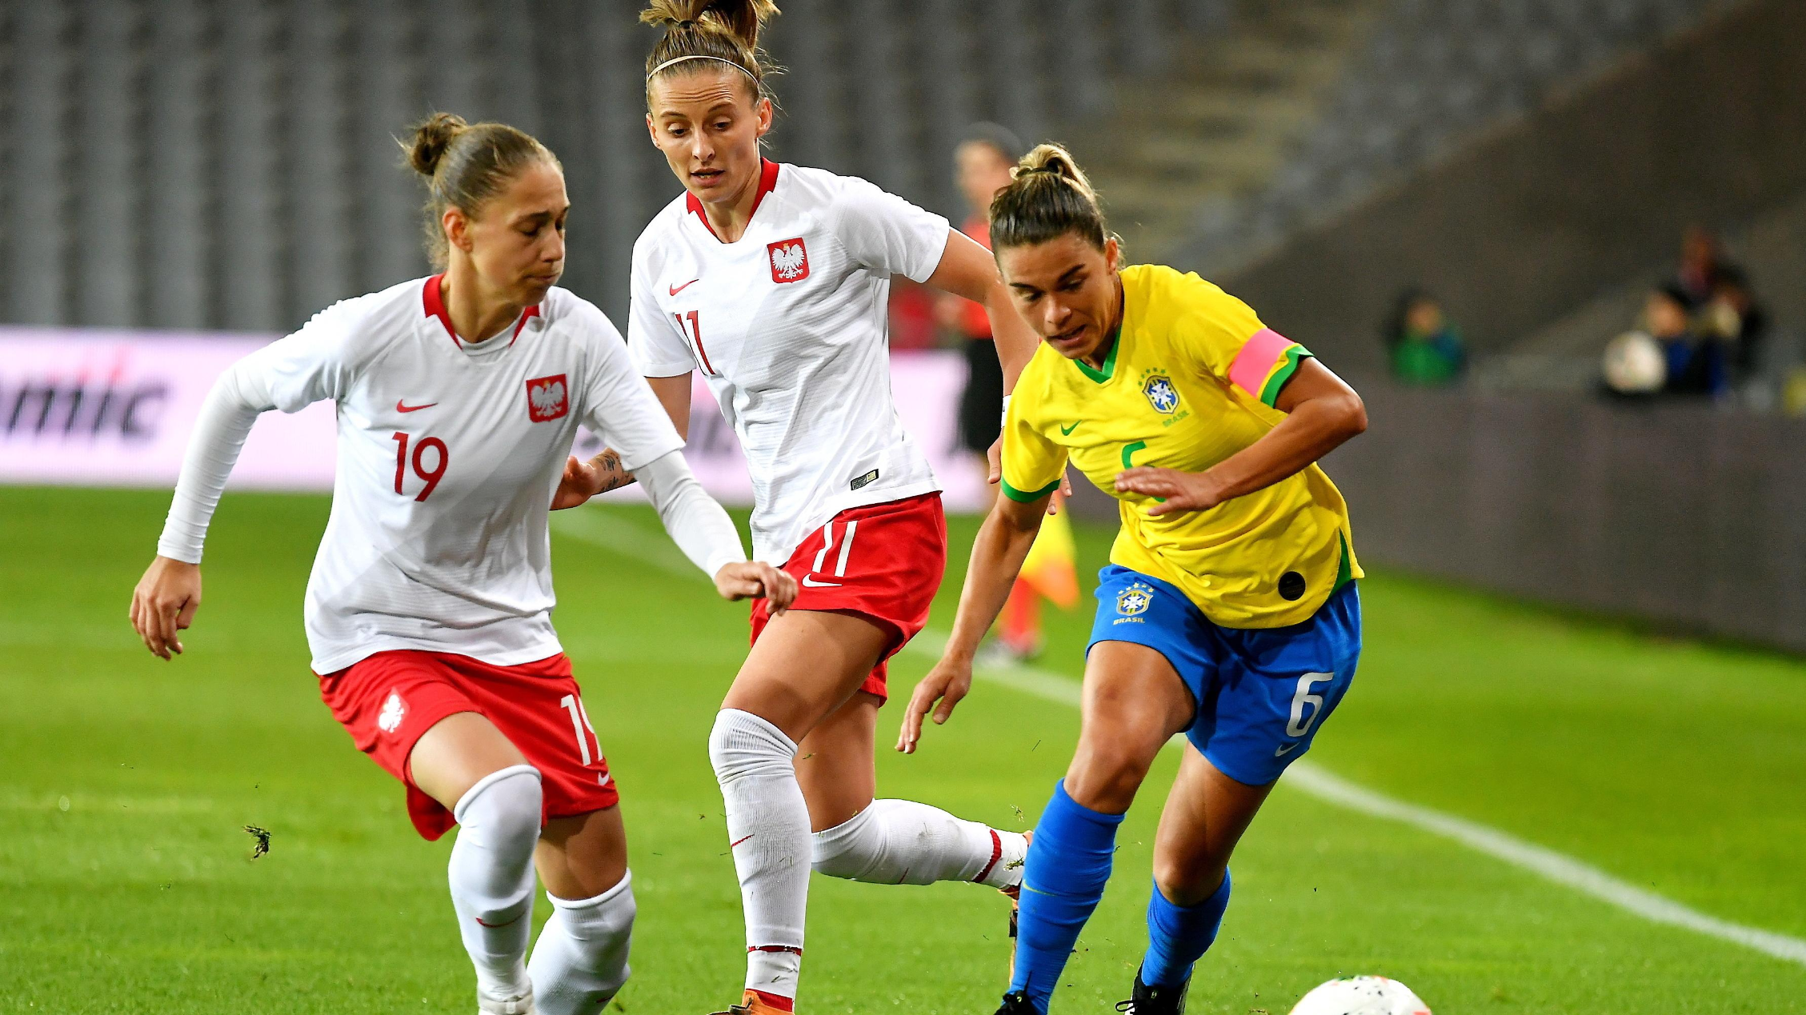

Slide 4
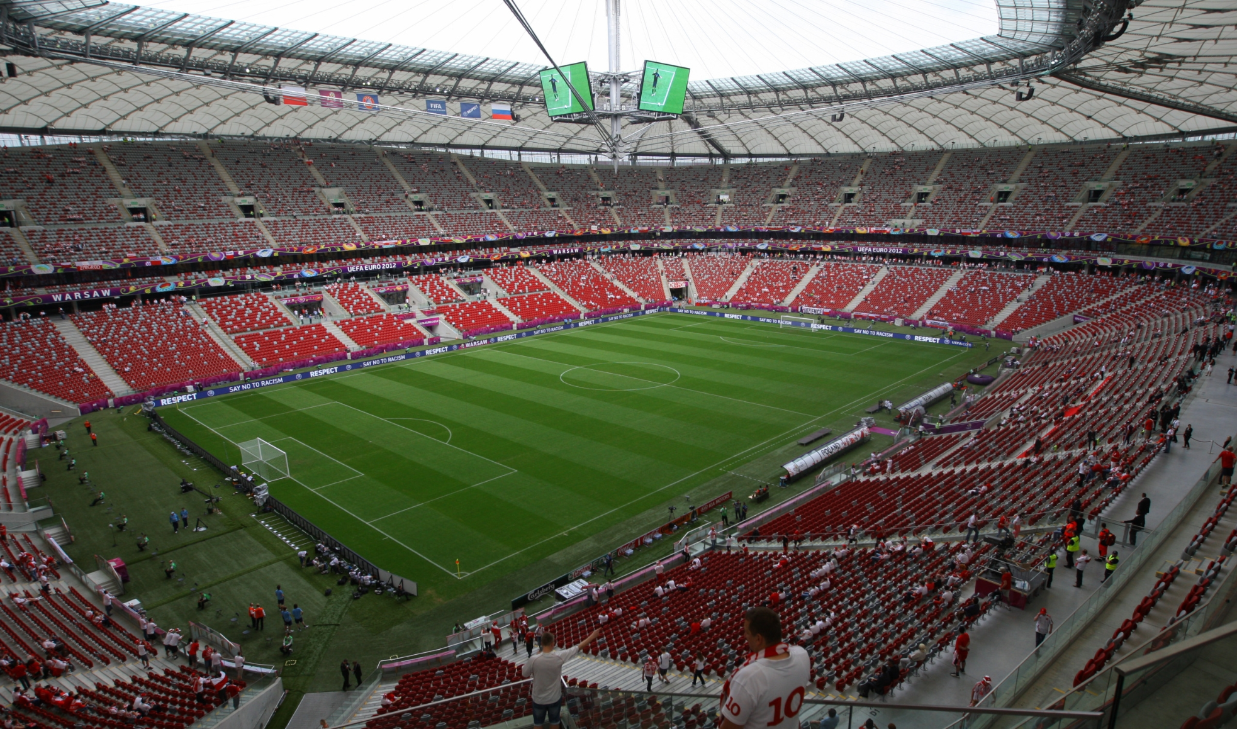

Slide 6
