Slide 1
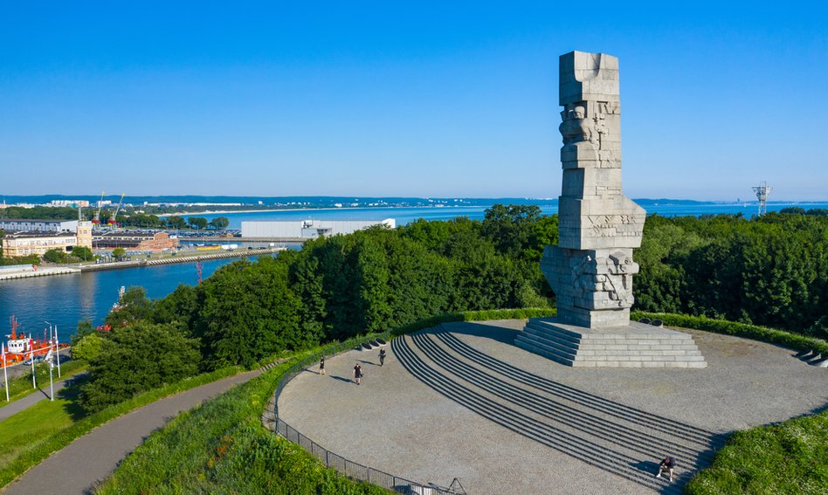
Westerplatte
Famous Historical Place

Slide 2
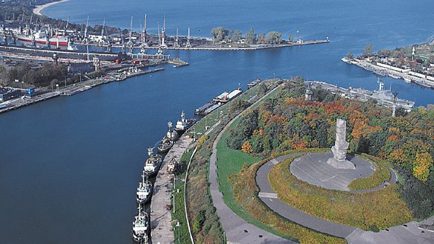
Westerplatte
A peninsula (formerly an island) in Gdańsk, formed in the years 1845–1847, at the mouth of the Dead Wisła river into the Gdańsk Bay.
In the years 1926–1939 an exclave of the Republic of Poland inside the territory of the Free City of Gdańsk, a symbol of the outbreak of World War II. In the interwar period, the Military Transit Depot operated in Westerplatte, the defense of which in September 1939 became a symbolic beginning of World War II and Polish resistance against the aggression of the Third Reich. The sites associated with the battlefield for Westerplatte were entered on the list of Historical Monuments on September 1, 2003.

Slide 3
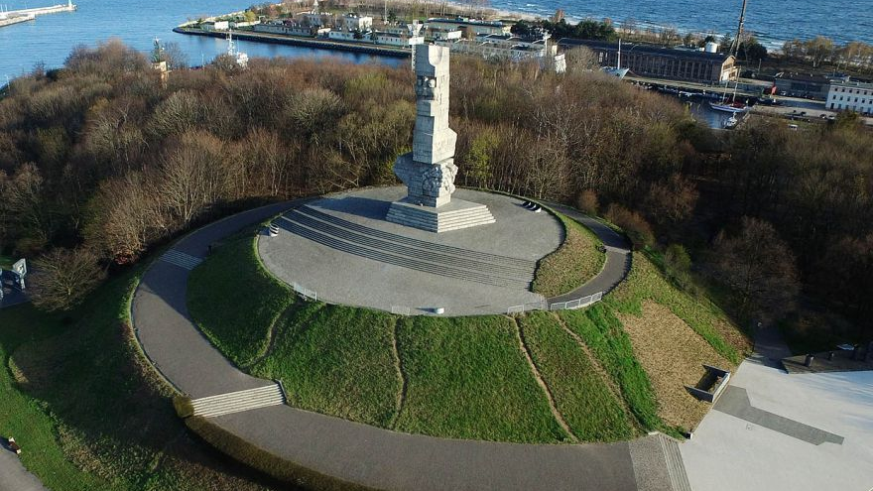
Until 1939
In May 1734, the 2,500-strong French corps of the intervention county of Ludwik de Plélo (who himself died there) landed here, trying to break the siege of Gdańsk by the Russians during the war of the Polish succession. In 1835 the first bathing establishment was established. The establishment of the resort was built into a semi-high-school resort. It was one of the shortest operating Gdańsk bathing grounds. It ceased to function before World War II. In 1880, "Weichsel" purchased a part of the peninsula, set up a harbor for ships from Gdańsk and built a spa house with a pier.
On March 14, 1924, the Council of the League of Nations granted Poland the area on the Westerplatte peninsula, the mouth of the port conduit to the sea, opposite the Nowy Port suburb. On October 31, 1925, the area in the Free City of Gdańsk on the Westerplatte peninsula was introduced to Poland in indefinite and free of charge news.
On December 7, 1925, the League of Nations granted Poland the right to operate the military guard at Westerplatte. On January 18, 1926 at At 2 p.m. there is the first branch on the ORP Mewa minesweeper and the implementation of the guard service was launched. In the years 1926–1939, the Military Transit Depot operated on the peninsula.

Slide 4
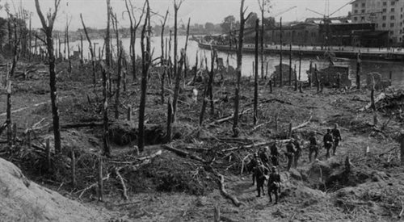
World War II
After World War II
Monument to the Coastal Defenders in Westerplatte
Remains of new barracks in Westerplatte (as of 2010)
Cemetery of the Fallen Defenders of Westerplatte
On October 9, 1966, a 25-meter-high Monument to the Coastal Defenders by prof. Adam Haupt, on a 20-meter mound. The shape of this monument resembles a jagged bayonet stuck in the assessment. During the reconstruction of the area, part of the ruins of the barracks was demolished; in 1967, when widening the port canal, the Guardhouse No. 1 was moved on rails.
On June 12, 1987, John Paul II met 38 Westerners and young people there. During the works on the construction of Trasa Sucharskiego 2011, there was one year left, an unknown concrete breakwater or pier, which was several dozen meters from the shore.
From the end of the war, units of the Polish Army have been stationed in Westerplatte.

Slide 5
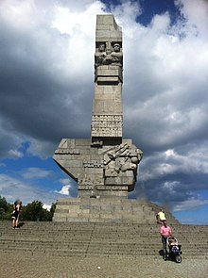
Name
The name Westerplatte (formerly West Platte) comes from the German language. West is "western" and platte is "plate" (meaning "island"). Westerplatte then means "the western island". According to the name of Westerplatte, it was still an island in the 19th century, and the term "western" was used to distinguish the island from the then existing also Ost Platte ("eastern island"), which later merged with the mainland. The name was kept as it became a symbol of the fight for freedom.

Slide 6
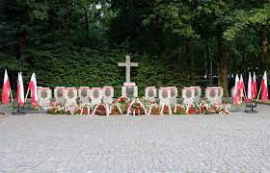
How many Polish soldiers died?
In the defense of Westerplatte, 16 soldiers were killed and 50 were wounded. At 4:30 a.m. on September 1, 1939, the German battleship Schleswig-Holstein unmoored from the quay and headed towards the bend of the port channel, known as the Five Whistles Turn.

Slide 7
The End

