Slide 1
Team games

Slide 2
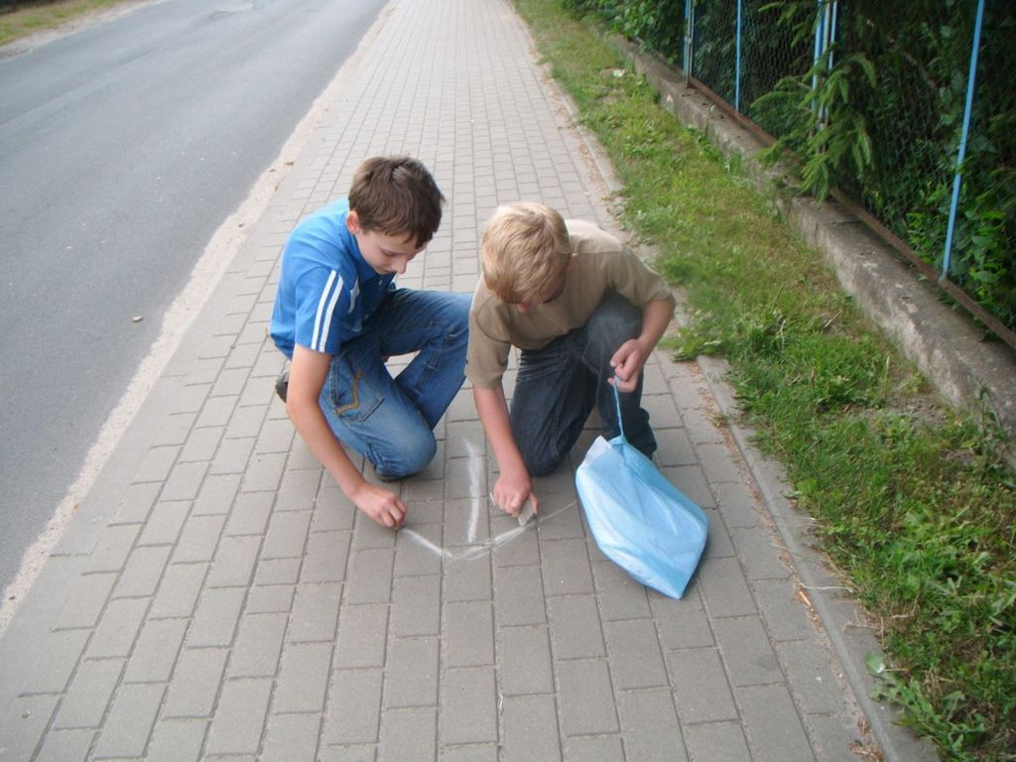
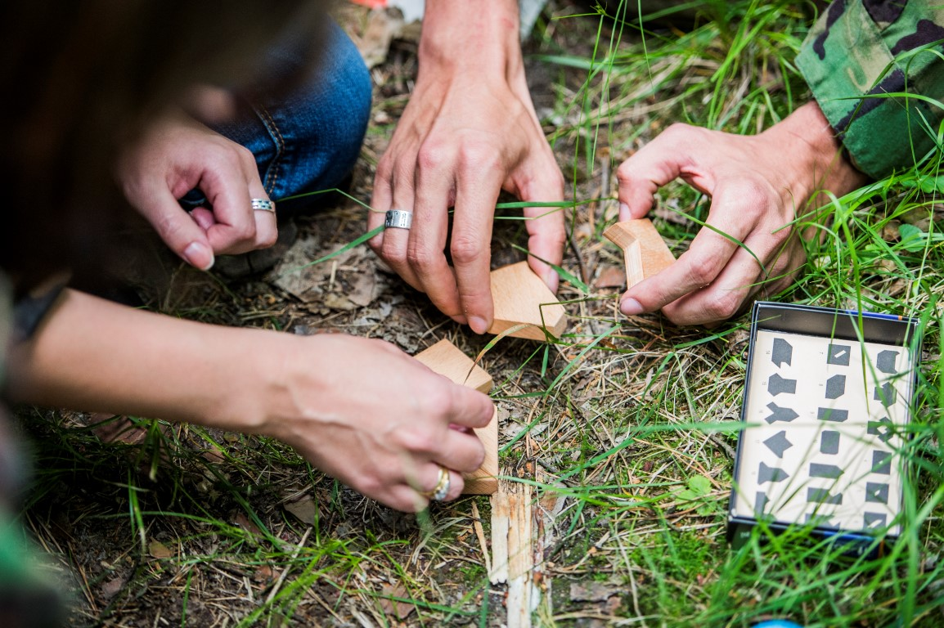
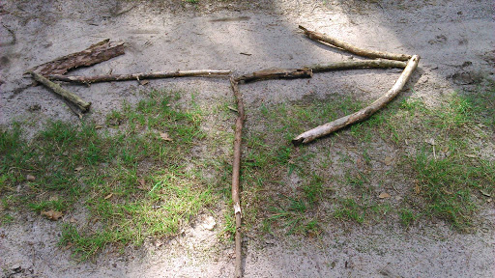
Scavenger hunt
A field game that can be played at any time of the year.

Slide 3
Game rules
- At least two groups are involved
- The first group starts and leaves characters and tasks with each other
-then the second group will go out and find and do it tasks

Slide 4
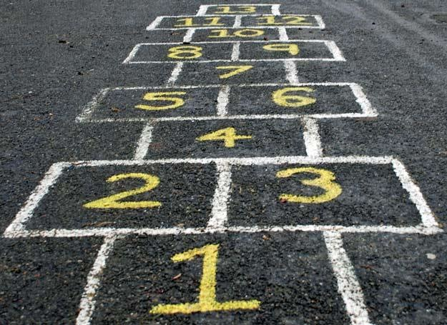
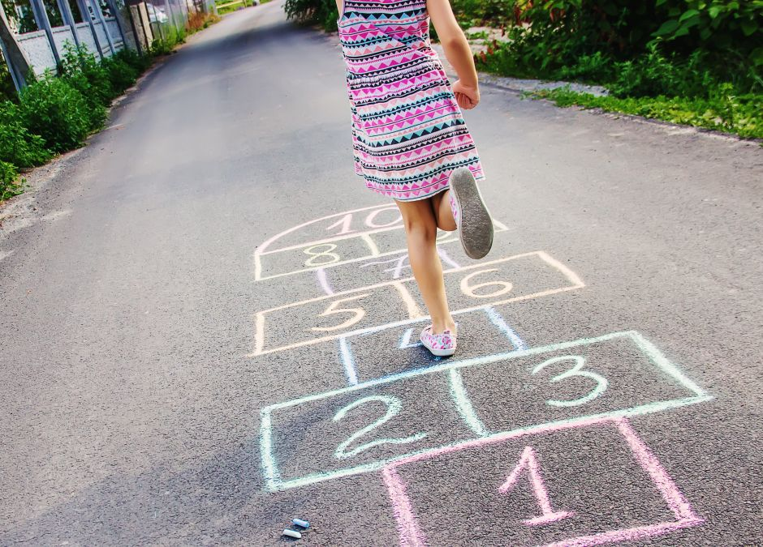
Plays in class

Slide 5
Game rules
-Draw a box to play
-you need a chalk and a stone to play
-It's a mobility experience for at least two children

